Slide 1
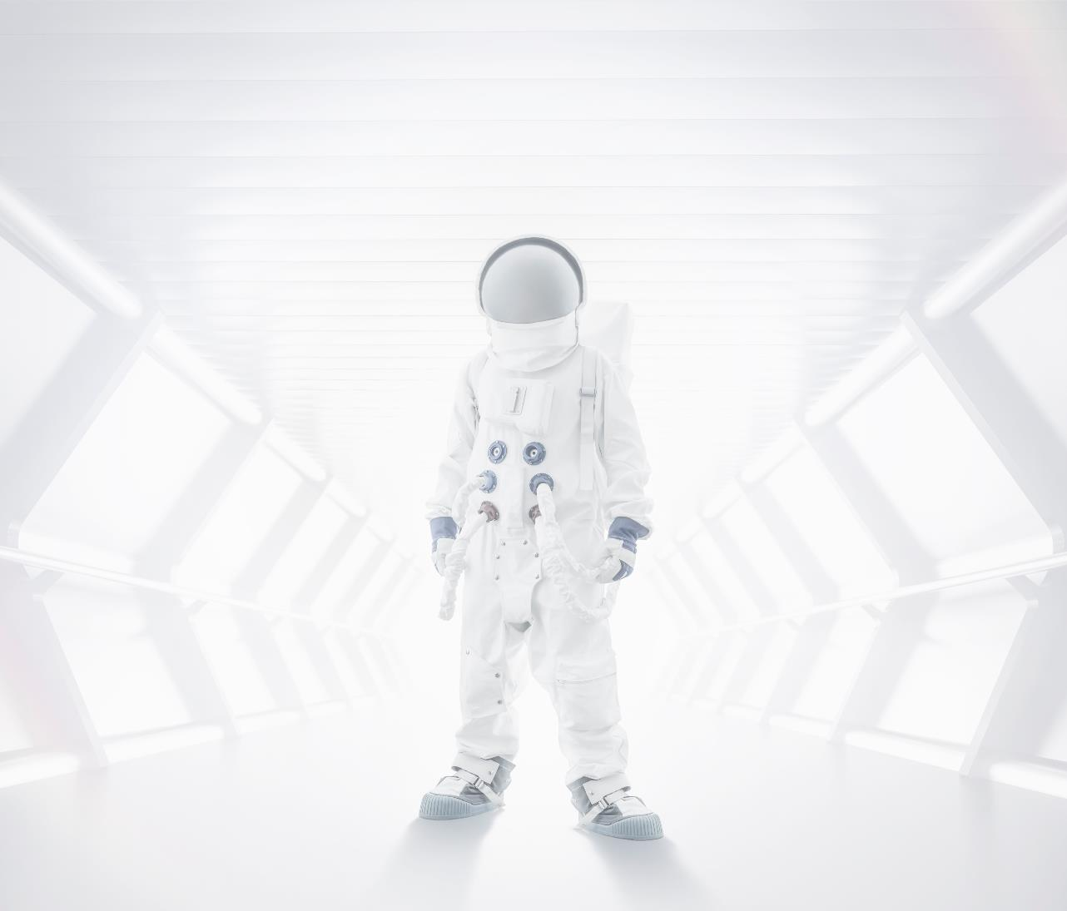
JOY OF COMPUTING
An equation has no meaning to me... unless it expresses a thought of God..
-- RAMANUAN

Slide 2
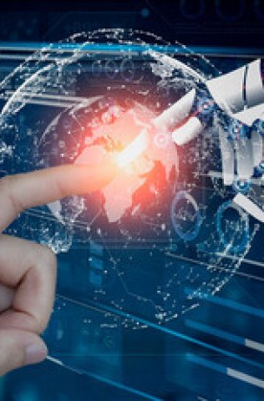
Unleashing the Power of Machine Learning: Image Processing Techniques with Python
- You are not as good as your grades and not as bade as your c.v.

Slide 3
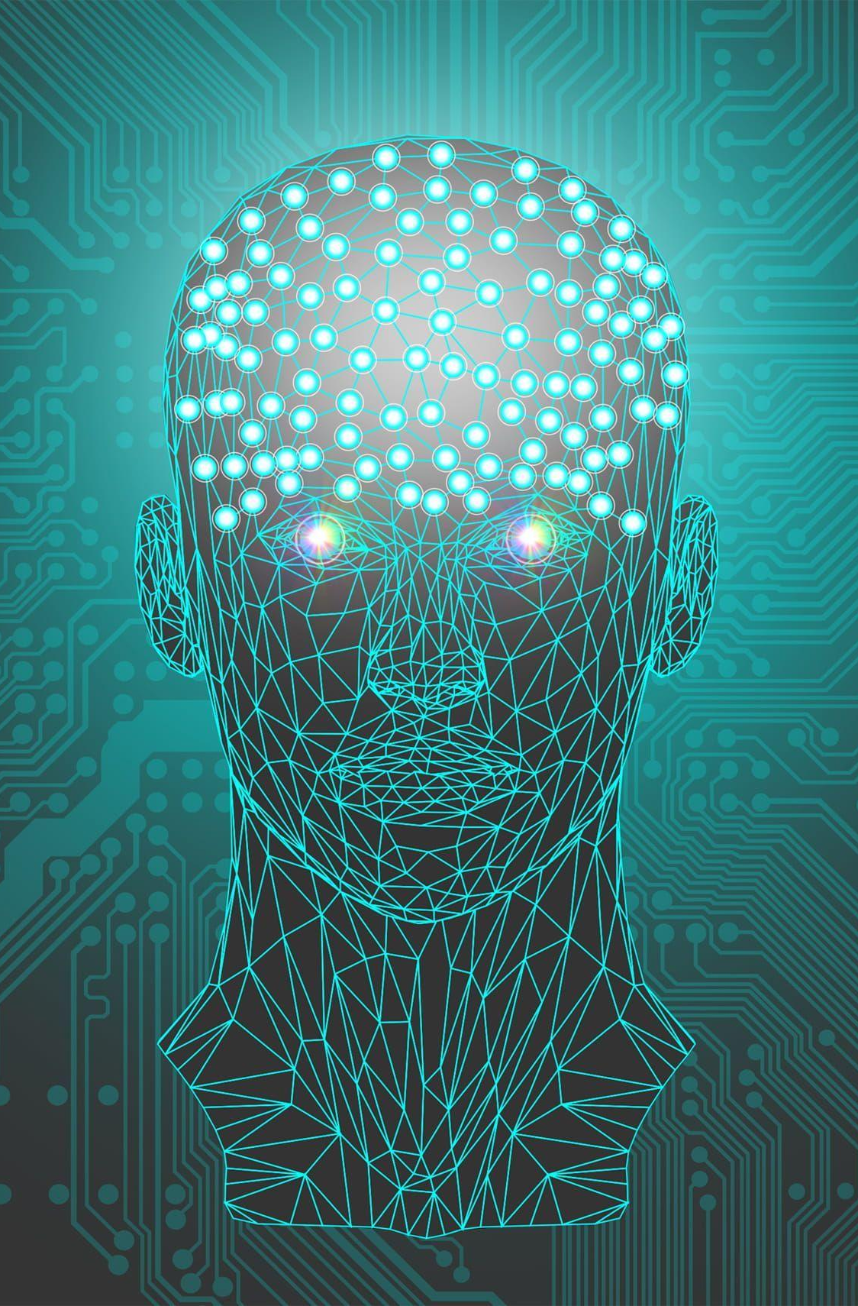
Introduction to M.L. & A.I
Artificial Intelligence (AI): AI is a broad field that encompasses the development of systems and machines capable of performing tasks that would typically require human intelligence. This includes reasoning, problem-solving, understanding natural language, and perception. AI aims to create systems that can mimic human cognitive functions. It can be categorized into two main types:
Narrow AI (or Weak AI): Designed and trained for a specific task or a set of related tasks. Examples include voice assistants like Siri, recommendation systems on streaming services, and image recognition software.
General AI (or Strong AI): Hypothetical at this stage, this type would have the ability to understand, learn, and apply intelligence across a wide range of tasks, similar to human cognitive abilities.

Slide 4
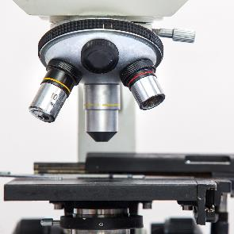

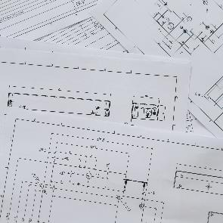
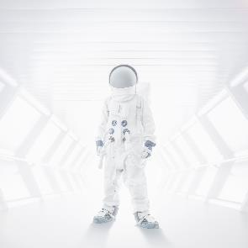
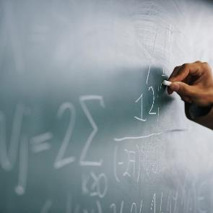

Machine Learning (ML): ML is a subset of AI focused on developing algorithms and statistical models that allow computers to learn from and make predictions or decisions based on data. Instead of being explicitly programmed for a task, ML systems are trained on large amounts of data to identify patterns and make inferences. Key concepts in ML include:
Supervised Learning: Involves training a model on a labeled dataset, meaning that the input data is paired with the correct output. The model learns to map inputs to outputs and can make predictions on new, unseen data.
Unsupervised Learning: Involves training a model on data without labeled responses. The goal is to identify underlying structures or patterns in the data, such as clustering similar data points together.
Reinforcement Learning: Involves training an agent to make decisions by rewarding desired behaviors and penalizing undesired ones. The agent learns to optimize its strategy through trial and error.
Semi-Supervised and Self-Supervised Learning: Techniques that leverage a mix of labeled and unlabeled data (semi-supervised) or use the data itself to create labels for training (self-supervised).
1
2
3
4
5
6

Slide 5
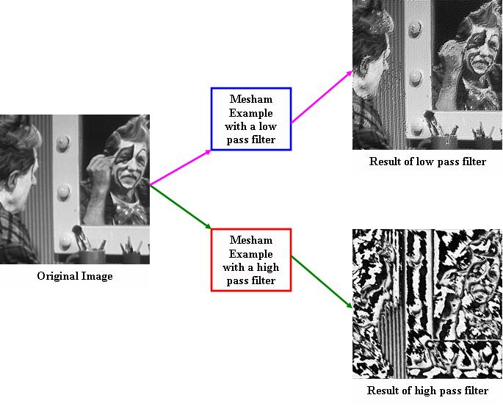
Deep Learning: A subfield of ML that uses neural networks with many layers (deep neural networks) to model complex patterns in data. Deep learning has been particularly successful in tasks like image and speech recognition, natural language processing, and game playing.
Applications: AI and ML are used in various domains, including:
Healthcare: Diagnostics, personalized medicine, and medical imaging.
Finance: Fraud detection, algorithmic trading, and credit scoring.
Transportation: Autonomous vehicles and route optimization.
Entertainment: Content recommendations, personalized advertising, and game design.
Overall, AI and ML are transforming industries by enabling machines to perform tasks with increasing sophistication and accuracy. They hold significant promise for future advancements, but also raise important ethical and societal questions, such as concerns about privacy, bias, and job displacement.

Slide 6
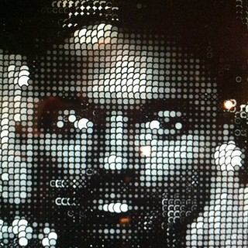
Image processing involves manipulating images to improve their quality or extract useful information. Techniques such as filtering, segmentation, and enhancement are essential in preparing images for further analysis using Machine Learning algorithms.
Python offers numerous libraries for image processing, including OpenCV, PIL, and scikit-image. These libraries provide powerful tools for tasks like image manipulation, feature extraction, and machine learning model training to analyze visual data.

Slide 7
Charts and Graphs 2
Data A
Data B
Data C

Slide 8
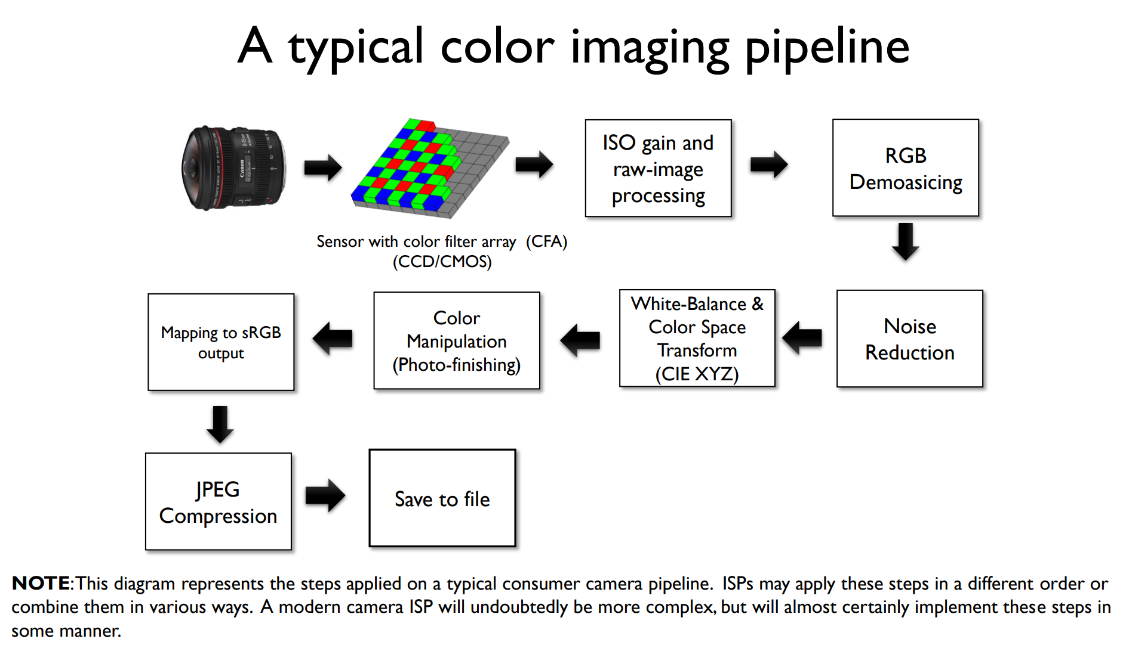

Slide 10
TENSOR FLOW
TensorFlow is an open-source machine learning and deep learning framework developed by Google. It's widely used for building and deploying machine learning models and provides a comprehensive ecosystem of tools, libraries, and community resources.
Image processing in Python is a rapidly growing field with a wide range of applications. It is used in a variety of industries, including Computer vision, medical imaging, security, etc.
In this article, we’ll look at how to use OpenCV in Python to process the images.
What is Image Processing?
Image processing is the field of study and application that deals with modifying and analyzing digital images using computer algorithms. The goal of image processing is to enhance the visual quality of images, extract useful information, and make images suitable for further analysis or interpretation.

Slide 11
The laptop thief. binary search. Number in my mind.
Binary search is a search algorithm used to find the position of a target value within a sorted array. It works by repeatedly dividing the search interval in half until the target value is found or the interval is empty. The search interval is halved by comparing the target element with the middle value of the search space.
DSA (what are you think about it?)
Binary search is a search algorithm used to find the position of a target value within a sorted array. It works by repeatedly dividing the search interval in half until the target value is found or the interval is empty. The search interval is halved by comparing the target element with the middle value of the search space.
TIME COMPLEXITY = 0(log(n))

Slide 12
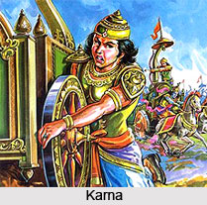
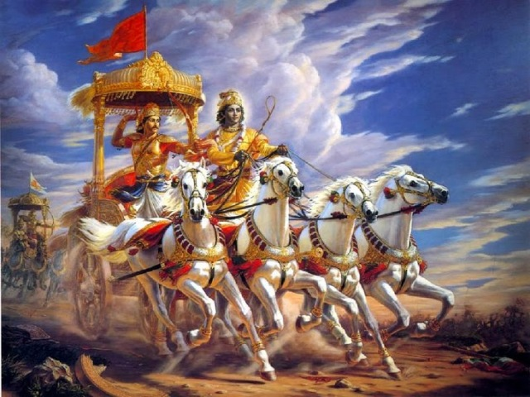
Mahabharat karn problem ?
Binary search is a search algorithm used to find the position of a target value within a sorted array. It works by repeatedly dividing the search interval in half until the target value is found or the interval is empty. The search interval is halved by comparing the target element with the middle value of the search space.
KARNA (Can you help me to win this war ?)
KARN lost in Mahabharat by lost but this time you have to
Succeed him but the challengefor you is that the arjun is one of the best warrior with lord sri krishna (three lok swami)

Slide 13
Charts and Graphs
20YY
20YY
Data A
Data B
Data C

Slide 14

Large Image slide

Slide 15


Thank You
SANATAN SINGH
rashmisingh00001@gmail.com

